Slide 1
Compare-SharedUserFile.ps1

Slide 2
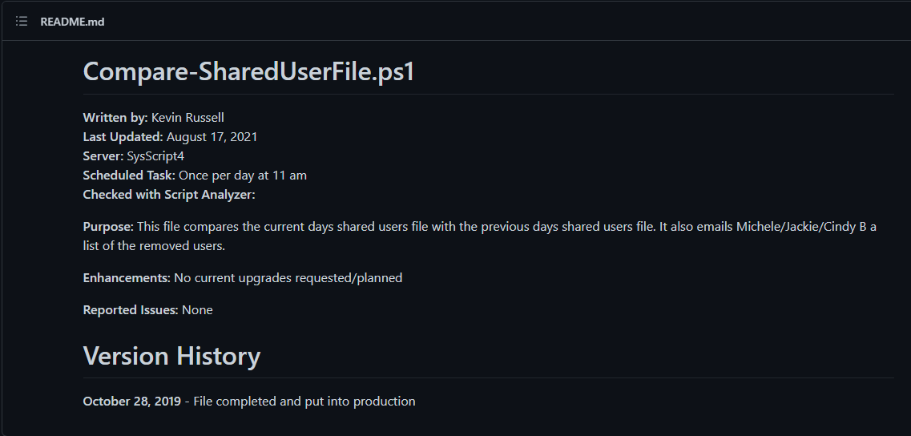

Slide 3


Slide 4
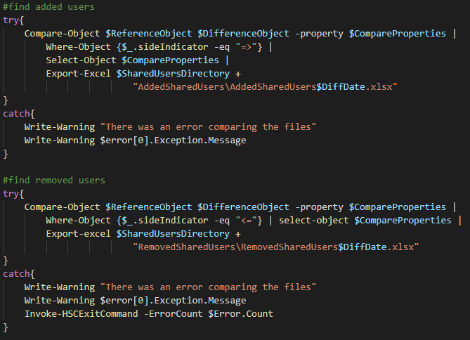

Slide 5

Removed Shared User file

